Slide 1
Agency with Choice Provider Electronic New Hire On-Boarding Process
Notes:
Before beginning training, we do the ice breaker with the new hires. Ask the new hires to talk to someone else (or a few people depending on how many there are) that ISN’T seated next to them. Ask them to get up and walk across the room to someone else, so that they get a chance to chat with and get to know more than just the person sitting next to them that day. Tell them that they need to talk to the other person and find out 3 things: what their name is, what their position will be/where they will be working and something interesting/unique/something personal about them (give examples: can be knitting, being obsessed with a certain tv show, having travelled or wanting to travel to a certain place). Tell them to make sure to REMEMBER what the other person says because they will have to introduce someone else!
After about 10 or so minutes or once the conversation begins dying down, ask everyone to come back to their seats and introduce yourself first based on the icebreaker criteria. Then open up the floor to everyone else.
Once everyone has been introduced, go through their schedules with them in the ‘Welcome Slide and Objectives’ Powerpoint and hand out their training checklist according to their respective service line. THIS is where it’s especially important to tell DDD about their online CDS trainings. Point these out on their checklists and let them know they have the option of staying after Crisis Management the next day to begin their CDS trainings here, but that they can also be done at home. These MUST be done before they can begin working. Remind them to keep track of their time and input it into their timesheets and send an email to the training inbox once completed.

Slide 2
Welcome to our new On-Boarding Portal !
Financial Management Services Agency with Choice (AwC) has partnered with the 321 Forms automated on-boarding system to facilitate documents for the Self- Directed Employee (SDE) New Hire on-boarding.
Effective: September 8, 2020 we will require all newly hired SDE employees to complete their on-boarding documents through the 321 Forms portal.
The AwC HR On-Boarding Specialist is the administrator and point of contact of the tool and has the ability to view, acknowledge and/or distribute any required new hire forms to newly hired SDE employees.
.

Slide 3
What is 321 Forms?
321 forms is a completely digital on-boarding system that takes the “paper” out of the new hire paperwork process!
This completely digital process improves the new hire’s on-boarding experience by allowing employees to complete the necessary pre-employment forms & documents easily and accurately creating a more efficient, timely and streamlined on-boarding process.
Some benefits of the online process include:
Access to 321Forms from any device, including mobile phones & tablets.
Employees can quickly and easily fill out their paperwork remotely and securely from any location at any time using this simple onboarding solution.
Employee information is protected by high grade encryption & industry-standard Secure Sockets Layer (SSL)
No more trying to figure out illegible information. Forms are clear and easy to read eliminating the need to send forms back to the employee.
Ability to start completing forms on their tablet or smart phone and finish later on their laptop without skipping a beat!
System allows both the employee and the HR Onboarding Specialist to know when forms are 100% complete.

Slide 4
Introducing the new process to the Clients

Slide 5
Notification to the Support Coordinators
Any/all Support Coordinator partners will receive an email notification informing them of the NEW on-boarding process.
Support Coordinators will continue to be the liaison between the family Managing Employers as well as the Financial Management Services AwC team.
This is our new process for onboarding SDE’s so all parties (SC, ME, CSR, etc. must communicate the process effectively.
Remember, Communication is KEY!!

Slide 6
Notifying Consumers/Families/ Managing Employers
Consumer families (Managing Employer) will receive notification that includes complete instructions on what forms they need to complete and how the SDE will be completing their portion of the pre-employment documents via the 321 Forms system.
For consistency, the ME will be instructed to direct any questions or concerns to the Customer Service team or to the AwC general email mailbox
To ensure timely response and maintain consistency, email inquires should NOT be directed to the HR Onboarding Specialist (Remiah) personal (work) email

Slide 7
The New Hire SDE Experience

Slide 8
Introducing 321 Forms to the New Hire SDE
The new hire SDE will receive a welcome email introducing them to the 321 Forms on-boarding system, outlining the steps that they need to take to activitate their login and complete their pre-employment documents electronically.
For ease of using the system, the SDE will a user guide with screen shots for step-by-step navigation.
A forms definition guide will also be provided so ensure the SDE understands what forms they are completing and why.

Slide 9
SDE Welcome email and system activation
SDE new hire employees will be set up in the 321 Forms onboarding system by the AwC HR Onboarding Specialist to initiate the onboarding process.
Once established, the SDE will receive an automated email from the system with a User Name and temporary password to activate their account and login to the 321 Forms system to begin completion of their pre-employment documents.
Employees can get Technical Support by visiting :
https://my321forms/content/
support/

Slide 10
Sample Employee Activation Email

Slide 11
Employee Activation Login

Slide 12
321 Forms LOGIN PAGE
After the SDE has activated their account, they will be able to log into the system.
We will recommend that the SDE make this page a favorite for easy future access.
Note: The login landing page has a link for assistance and forgot password if needed.

Slide 13
Account Activation/Password Confirmation: Employee must change their password to one of their own to continue account activation

Slide 14
SDE Employee Portal: Getting Started
Before filling out the new hire forms, the system requires the newly hired SDE employee to provide some basic information about themselves by completing a standard questionnaire.
This information is used to populate the rest of the forms

Slide 15
Consent to Electronic Disclosure
Before completing new hire documents, the SDE must agree to the electronic signature consent prior to continuing the electronic process.
Employees that do not agree will not be able to continue with the online onboarding process.

Slide 16
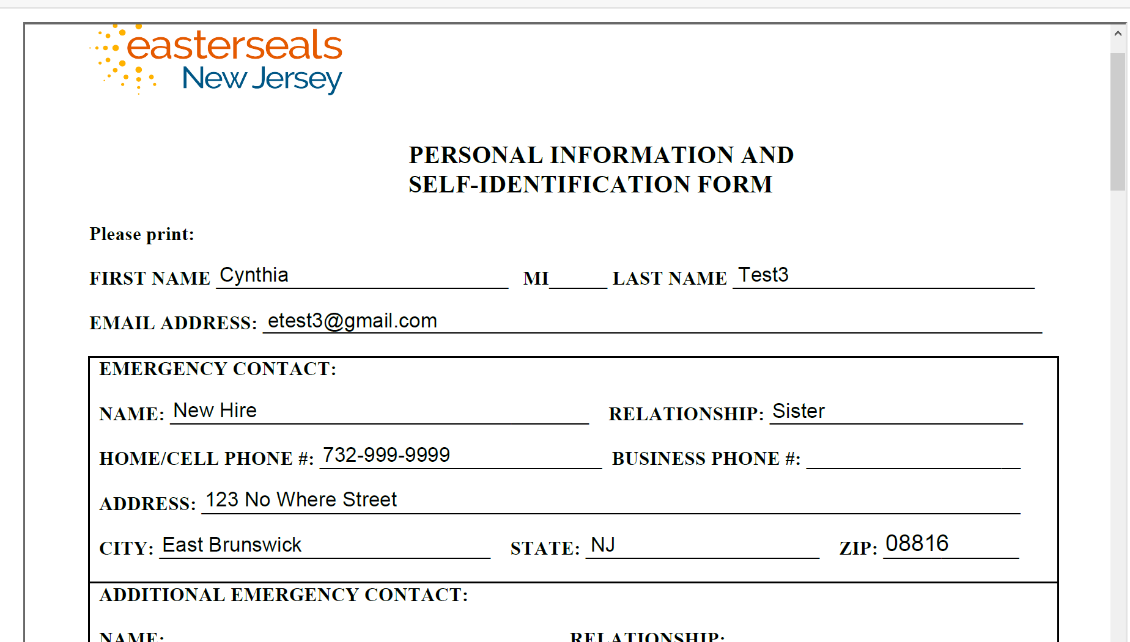
All forms will be pre-populated based on the information provided by the SDE in the basic information area. No need to enter this information over & over again on the forms!

Slide 17
Completing the Forms
The SDE employee is now ready to complete their forms!
Required pre-employment documents/forms are listed so that the employee can see exactly what forms they will need to complete their onboarding documents.
The SDE will click the “Fill Out My Forms” link to get started.

Slide 18
Federal & State W-4 Form Completion
The employee will answer the required questions for both the Federal & State W-4 forms.
This information will be pre-populated onto the actual forms for review and electronic signature.

Slide 19
Employee View & Sign Forms
The SDE employee is now ready to view each completed form and enter their electronic signature to complete the process and submit for approval.

Slide 20
Viewing the documents
To ensure accuracy, each document is provided in a PDF format so that the SDE employee can review. The employee can also save or print the document if needed.

Slide 21
The Confirmation Box
After viewing each form in the PDF format, the SDE employee must confirm that the form has been completed accurately with the pre-populated information before moving on to the next form.
At this step in the process, the employee can confirm to continue to the next step or skip the submission of the form, which allows them to go back and make any applicable corrections.

Slide 22
Electronic Signature
The electronic signature page will be presented for any forms that require a signature from the SDE employee. After the signature is entered, the employee can click the submit my form button to continue.

Slide 23
Successful Completion!
The SDE employee can now go to their employee dashboard to manage their account.

Slide 24
Employee Dashboard my321forms.com
The Employee Dashboard provides a home page that allows employees quick links to easily view and manage their information, forms & documents, including the ability to upload any required documents effectively.
Employees can access their documents/forms at any time during or after completion by logging into the my321forms.com site to access their Employee Dashboard.
Employees can also send and receive email communications within the 321 forms system!
The ease of use and navigation capabilities allow employees to complete their forms faster and without wasted time.

Slide 25
The Employee Dashboard
Each area of the employee dashboard is expandable to allow the employee to manage their forms; upload additional forms; print forms or edit their employee information.
The AwC HR Specialist will receive a notification alert to inform them that the SDE employee has made a change to their profile (i.e.. Change of address; phone number or email address)

Slide 26
THE WORKFLOW

Slide 27
SDE On-Boarding Process Flow
SDE New Hire Request
SDE Onboarding
Screenings
On-Boarding Completion
SDE Approved for hire
Completion of compliance screenings
SDE cleared to Work
Initiate Onboarding
Application &
Onboarding Management
Support Coordinator sends approved request for SDE New Hire
AwC HR Specialist confirms approval ans initiates NH Onboarding
Pre-employment document completion
AwC HR Specialist initiates online onboarding
Electronic onboarding completed via 321 Forms online system
Drug, Background & DDD Compliance screenings
Drug Screen
Background
Fingerprinting
AwC HR Specialist initiates compliance screenings
SDE New Hire On-Boarding Completed
HR Onboarding specialist notifies ME & SDE of pre-employment completion
SDE starts work
New Hire SDE entered into Beyond Pay; Time Sheets are initiated by HR Representative

Slide 28
Resources
HR On-Boarding Specialist: Remiah Soto: (New Hire Inquiries)
HR Representative: Janet Marinelli: (SDE Time Sheets; Consumer Plan of Care)
HR Representative: Keisha London
HR Onboarding Manager: Cynthia Martin (Escalations)
AwAwC Customer ServiceRsoto@nj.easterseals.com
AwC Email: AwcHR@nj.easterseals.com
AwC Fax: 732-432-5970
AwC Customer Service: 1-800-471-3086
321 Forms Technical Support: Monday through Friday, 10am-6:30pm EST
Support@321forms.com

